Slide 1



AWS CERTIFIED SOLUTIONS ARCHITECT - ASSOCIATE
Machine Learning
AMBER ISRAELSEN
Developer | Technical Trainer
Notes:
m16-01 = “Module Introduction”
Hi everyone, and welcome back to this next module in the course AWS Certified Solutions Architect – Associate. I’m still Amber Israelsen, and really appreciate you sticking with me.

Slide 2
Course Outline (Part 2)
Monitoring
Security and Compliance
Automation and Governance
DNS and Network Routing
Application Integration
Machine Learning
Backup and Recovery
Billing and Pricing
The Well-Architected Framework
Preparing for the Exam
Notes:
We’re up to our module about machine learning. As you probably know by now, machine learning is becoming more and more pervasive in our everyday lives, and AWS is at the front of a lot of that innovation, using ML themselves, and offering many services for YOU to do ML work.
Artificial intelligence and machine learning are huge topics–-there’s actually a specialty certification you can get about it. For the Solutions Architect exam, the questions won’t make up a big portion of the exam, but you may get some questions that test whether you understand some of the core artificial intelligence and machine learning services and what they do. So this module will be pretty high level and conceptual, focusing on the core use cases for the various services.
Let’s go.

Slide 3
















AI SERVICES
VISION
SPEECH
LANGUAGE
CHATBOTS
FORECASTING
RECOMMENDATIONS
REKOGNITION IMAGE
REKOGNITION VIDEO
TEXTRACT
POLLY
TRANSCRIBE
TRANSLATE
COMPREHEND & COMPREHEND MEDICAL
LEX
FORECAST
PERSONALIZE
ML SERVICES
GROUND TRUTH
NOTEBOOKS
ALGORITHMS + MARKETPLACE
REINFORCEMENT LEARNING
TRAINING
OPTIMIZATION
DEPLOYMENT
HOSTING
AMAZON SAGEMAKER
ML FRAMEWORKS + INFRASTRUCTURE
FRAMEWORKS
INTERFACES
INFRASTRUCTURE
TENSORFLOW
MXNET
GLUON
PYTORCH
KERAS
EC2
INFERENTIA
ECS
EKS
DL CONTAINERS & AMIs
ELASTIC INFERENCE
GREENGRASS
Notes:
m16-02 = “The AWS Artificial Intelligence and Machine Learning Stack”
There’s a lot happening on this slide—and that’s kind of the key takeaway. Amazon has a lot of offerings in the AI and ML space, and they’re growing every day.
Breaking this into the three main parts…

Slide 4
AI SERVICES
VISION
SPEECH
LANGUAGE
CHATBOTS
FORECASTING
RECOMMENDATIONS
REKOGNITION IMAGE
REKOGNITION VIDEO
TEXTRACT
POLLY
TRANSCRIBE
TRANSLATE
COMPREHEND & COMPREHEND MEDICAL
LEX
FORECAST
PERSONALIZE
ML SERVICES
GROUND TRUTH
NOTEBOOKS
ALGORITHMS + MARKETPLACE
REINFORCEMENT LEARNING
TRAINING
OPTIMIZATION
DEPLOYMENT
HOSTING
AMAZON SAGEMAKER
ML FRAMEWORKS + INFRASTRUCTURE
FRAMEWORKS
INTERFACES
INFRASTRUCTURE
TENSORFLOW
MXNET
GLUON
PYTORCH
KERAS
EC2
INFERENTIA
ECS
EKS
DL CONTAINERS & AMIs
ELASTIC INFERENCE
GREENGRASS
Notes:
Generally speaking, it goes from higher-level and abstracted at the top of the diagram—where you don’t want to deal with the details of building and training the machine learning model yourself.

Slide 5
AI SERVICES
VISION
SPEECH
LANGUAGE
CHATBOTS
FORECASTING
RECOMMENDATIONS
REKOGNITION IMAGE
REKOGNITION VIDEO
TEXTRACT
POLLY
TRANSCRIBE
TRANSLATE
COMPREHEND & COMPREHEND MEDICAL
LEX
FORECAST
PERSONALIZE
ML SERVICES
GROUND TRUTH
NOTEBOOKS
ALGORITHMS + MARKETPLACE
REINFORCEMENT LEARNING
TRAINING
OPTIMIZATION
DEPLOYMENT
HOSTING
AMAZON SAGEMAKER
ML FRAMEWORKS + INFRASTRUCTURE
FRAMEWORKS
INTERFACES
INFRASTRUCTURE
TENSORFLOW
MXNET
GLUON
PYTORCH
KERAS
EC2
INFERENTIA
ECS
EKS
DL CONTAINERS & AMIs
ELASTIC INFERENCE
GREENGRASS
Notes:
Then in the middle, with SageMaker, you have a lot more control, but SageMaker is still doing a lot of the heavy lifting.

Slide 6
AI SERVICES
VISION
SPEECH
LANGUAGE
CHATBOTS
FORECASTING
RECOMMENDATIONS
REKOGNITION IMAGE
REKOGNITION VIDEO
TEXTRACT
POLLY
TRANSCRIBE
TRANSLATE
COMPREHEND & COMPREHEND MEDICAL
LEX
FORECAST
PERSONALIZE
ML SERVICES
GROUND TRUTH
NOTEBOOKS
ALGORITHMS + MARKETPLACE
REINFORCEMENT LEARNING
TRAINING
OPTIMIZATION
DEPLOYMENT
HOSTING
AMAZON SAGEMAKER
ML FRAMEWORKS + INFRASTRUCTURE
FRAMEWORKS
INTERFACES
INFRASTRUCTURE
TENSORFLOW
MXNET
GLUON
PYTORCH
KERAS
EC2
INFERENTIA
ECS
EKS
DL CONTAINERS & AMIs
ELASTIC INFERENCE
GREENGRASS
Notes:
And then the bottom layer, where you’re comfortable working at the framework level and having more control of the underlying infrastructure.

Slide 7
AI SERVICES
VISION
SPEECH
LANGUAGE
CHATBOTS
FORECASTING
RECOMMENDATIONS
REKOGNITION IMAGE
REKOGNITION VIDEO
TEXTRACT
POLLY
TRANSCRIBE
TRANSLATE
COMPREHEND & COMPREHEND MEDICAL
LEX
FORECAST
PERSONALIZE
ML SERVICES
GROUND TRUTH
NOTEBOOKS
ALGORITHMS + MARKETPLACE
REINFORCEMENT LEARNING
TRAINING
OPTIMIZATION
DEPLOYMENT
HOSTING
AMAZON SAGEMAKER
ML FRAMEWORKS + INFRASTRUCTURE
FRAMEWORKS
INTERFACES
INFRASTRUCTURE
TENSORFLOW
MXNET
GLUON
PYTORCH
KERAS
EC2
INFERENTIA
ECS
EKS
DL CONTAINERS & AMIs
ELASTIC INFERENCE
GREENGRASS
Notes:
For exam purposes, if you get questions related to artificial intelligence or machine learning, they’ll likely focus on the AI services shown here on the top, so let’s get into those.

Slide 8
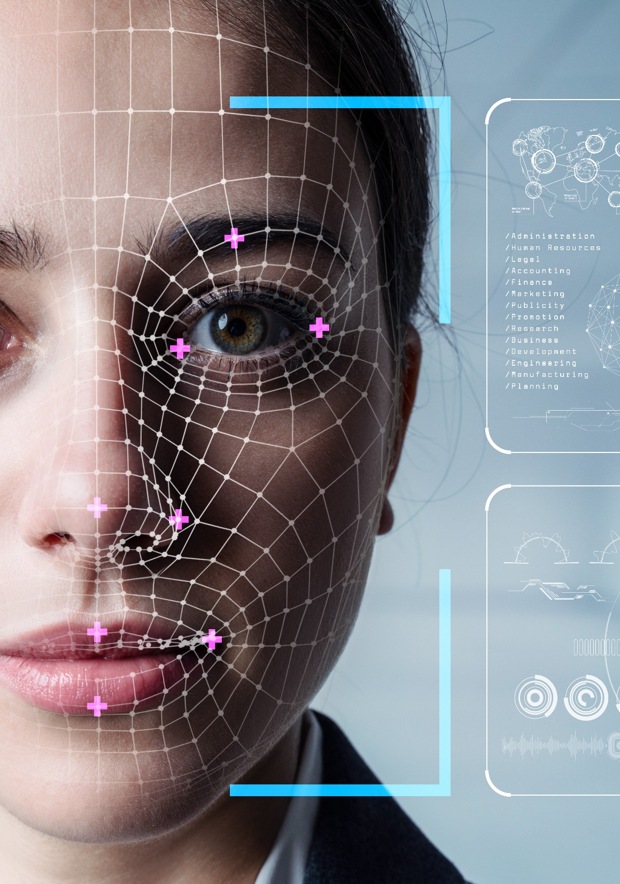
Rekognition Image
Facial recognition
Image search
Sentiment analysis
Image moderation
Face-based verification
Rekognition Video
Video search
Video moderation
Textract
Document import and processing
Text extraction for natural language processing (NLP)
Notes:
Starting with Vision
There are three services to know about here: Rekognition Image, Rekognition Video and Textract.
Rekognition Image is used for things like:
-Facial recognition
-Image search
-Sentiment analysis
-Image moderation
-Face-based verification
Rekognition Video, as you might suspect from the name, is for video, things like:
-Video search
-Video moderation
And finally, Textract, you can use this for:
-Document import and processing
-Text extraction for natural language processing (NLP)
This is just going to extract the text out, and then you can use other services like Comprehend to make sense of it.

Slide 9

Polly
Text-to-speech
E-books and training for the visually impaired
Announcement systems
Transcribe
Speech-to-text
Closed captioning and subtitles
Notes:
Speech
Those are Polly and Transcribe.
Polly
-Is the text-to-speech service. You’ll sometimes see the Polly logo has a parrot on it, so just remember that like a parrot, Polly is going to talk.
-Some uses cases here are reading e-books and training materials to the visually impaired
-And announcement systems
Transcribe is the reverse service, with speech-to-text. Here, someone talks and then Transcribe is going to type, or transcribe, what’s said.
-Some use cases for this would be closed captioning and subtitles
-Or maybe transcribing customer service calls

Slide 10

Translate
Natural-sounding language translation
Localization of applications
Multilingual sentiment analysis
Comprehend and Comprehend Medical
Natural language process (NLP) of text
Make sense of unstructured data such as emails, social media, reviews, and support tickets
Notes:
Now let’s look at the language services.
Here we have Translate and Comprehend, as well as Comprehend Medical, which is targeted at the healthcare industry.
Translate
-Produces natural-sounding language translation—so input English, for instance, and output French.
-A great use case here is when you need to localize applications for a global audience
-Or do sentiment analysis in multiple languages
Comprehend and Comprehend Medical
-Are all about making sense of text
-Use this make sense of unstructured data like emails, social media posts, reviews and support tickets

Slide 11

Lex
Conversational interfaces, using the same technology as Amazon Alexa
Call center bots
Informational bots
Productivity bots
Notes:
The service for this is called Lex. With Lex, you can build conversational interfaces, leveraging the same technology that powers Alexa.
Some common use cases here are:
Call center bots where the bot can do the initial intake and then pass the customer off to someone else if needed
Informational bots – things like what’s the weather forecast for next week
Productivity bots – to do things like schedule meetings, book travel tickets and so on.

Slide 12

Forecast
Time-series forecasting that takes in historical and related data
Sales forecasting
Financial planning
Resource planning
Notes:
Forecasting. With so much data at our fingertips today, wouldn’t it be nice to be able to make forecasts about the future?
And that’s what Forecast is all about.
It does time-series forecasting using historical and related data
-Some common uses are:
Sales forecasting
Financial planning
Resource planning

Slide 13

Personalize
Real-time personalization and recommendation
Similar item recommendations
Content recommendations
Personalized rankings
Notes:
Recommendations. We’ve touched on these a little bit as far as different algorithms that can be used to build and train a model.
But there’s a service for that too called Personalize.
This is all about personalizing the user experience in real time, so things like:
Similar item recommendations
Content recommendations
Personalized rankings
And that wraps it up for the top layer of AI services. Now let’s move down a layer to ML Services.

Slide 14
AI SERVICES
VISION
SPEECH
LANGUAGE
CHATBOTS
FORECASTING
RECOMMENDATIONS
REKOGNITION IMAGE
REKOGNITION VIDEO
TEXTRACT
POLLY
TRANSCRIBE
TRANSLATE
COMPREHEND & COMPREHEND MEDICAL
LEX
FORECAST
PERSONALIZE
ML SERVICES
GROUND TRUTH
NOTEBOOKS
ALGORITHMS + MARKETPLACE
REINFORCEMENT LEARNING
TRAINING
OPTIMIZATION
DEPLOYMENT
HOSTING
AMAZON SAGEMAKER
ML FRAMEWORKS + INFRASTRUCTURE
FRAMEWORKS
INTERFACES
INFRASTRUCTURE
TENSORFLOW
MXNET
GLUON
PYTORCH
KERAS
EC2
INFERENTIA
ECS
EKS
DL CONTAINERS & AMIs
ELASTIC INFERENCE
GREENGRASS
Notes:
Moving to the next layer down—ML services. This layer is going to be used more by data scientists and ML engineers to create their own prediction models and the like, using the Amazon SageMaker suite of products.
In the Console (go here, in Ohio), if you navigate to SageMaker and specifically Studio, here’s where you can work with your machine learning datasets, write your code, deploy machine learning models and share and collaborate with a broader team. We’re not going to actually DO anything here, but I just wanted to make SageMaker more concrete if you haven’t seen it before. This is the core offering for doing ML work.

Slide 15
AI SERVICES
VISION
SPEECH
LANGUAGE
CHATBOTS
FORECASTING
RECOMMENDATIONS
REKOGNITION IMAGE
REKOGNITION VIDEO
TEXTRACT
POLLY
TRANSCRIBE
TRANSLATE
COMPREHEND & COMPREHEND MEDICAL
LEX
FORECAST
PERSONALIZE
ML SERVICES
GROUND TRUTH
NOTEBOOKS
ALGORITHMS + MARKETPLACE
REINFORCEMENT LEARNING
TRAINING
OPTIMIZATION
DEPLOYMENT
HOSTING
AMAZON SAGEMAKER
ML FRAMEWORKS + INFRASTRUCTURE
FRAMEWORKS
INTERFACES
INFRASTRUCTURE
TENSORFLOW
MXNET
GLUON
PYTORCH
KERAS
EC2
INFERENTIA
ECS
EKS
DL CONTAINERS & AMIs
ELASTIC INFERENCE
GREENGRASS
Notes:
Now to the foundational layer.
This layer is for machine learning practitioners who want to get into the nitty-gritty details, using different frameworks and having more control of the underlying infrastructure.

Slide 16
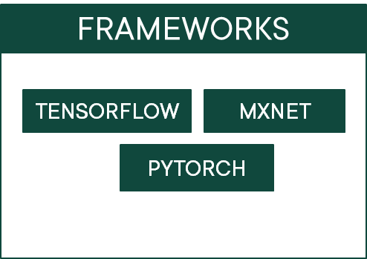
TensorFlow
Created by Google
Python, C++ and R
MXNet
Created by Apache
Python, C++, R, Julia, Perl and more
PyTorch
Created by Facebook
A Python library
Notes:
For frameworks, there are many out there, and Amazon supports TensorFlow, MXNet and PyTorch.
-TensorFlow was created by Google. It’s very popular today and has good community support. For languages, it supports Python, C++ and R.
-MXNet came from Apache. It supports multiple languages, including Python, C++, R, Julia, Perl and more.
-Facebook gave us PyTorch, and it’s grown in popularity in recent years. This is a Python library, and is favored for its flexibility and speed.

Slide 17
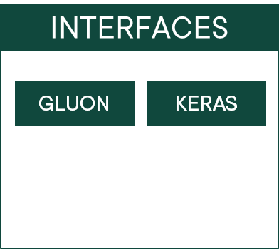
Gluon
Joint venture between AWS and Microsoft
Works with MXNet
Keras
Created by Francois Chollet (currently with Google)
Works with TensorFlow
Notes:
And then for interfaces, we have Gluon and Keras (click through). Where the frameworks we saw a minute ago were built more for developers, these interfaces are built more for researchers and other non-developer types.
They’re basically an interface or API TO the frameworks we just talked about—Gluon works with MXNet, and Keras sits on top of TensorFlow. And you’ll see where they originated.

Slide 18
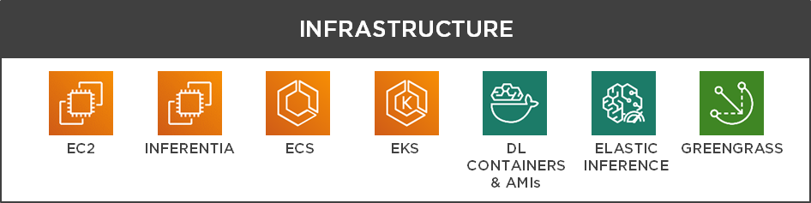
Infrastructure
Fully managed and mostly abstracted with SageMaker
Many ML-optimized instances available
Containers used for training and inference
Lower costs with Elastic Inference
Greengrass used for IoT ML
Notes:
The infrastructure bucket here—when you’re using SageMaker, most (click) of this is abstracted away from you. But if you’re working in the lower layer of the stack, you can have more control of your instances and containers. There are many EC2 instances (click) that are optimized for machine learning these days. Inferentia, that second icon over, is a chip designed to speed up the inference process. And then (click) containers, as we’ve seen, are used for training and inference with the model. (click) Elastic inference is a way to lower the cost of inference by attaching GPU-powered acceleration to your instances.
And I won’t get into too many details on Greengrass, but just know that this is used for running IoT devices, such as cameras or sensors in the field. Greengrass allows these devices to act locally with data they capture locally—which is important if they aren’t constantly connected to the internet—but then you can still publish data to the cloud for analytics and storage.

Slide 19
Important Points to Remember
TEXTRACT
Document import and processing
Extracts text (then can pass to other services like Comprehend)
COMPREHEND AND COMPREHEND MEDICAL
Natural language processing of text
Make sense of unstructured data like emails, social media, reviews, etc.
TRANSLATE
Natural-sounding translation
Example: Input English and output French
REKOGNITION IMAGE AND VIDEO
Facial recognition, image search, video search, etc.
Notes:
m16-03 = “Important Points to Remember”
This was a really short module, really just meant to highlight some of the core services that might come up on the exam. So let’s review those before we move on.

Slide 20
Important Points to Remember
POLLY
Text-to-speech (i.e., parrot reads a book)
Examples: Audio books and training for visually impaired, or announcement systems
TRANSCRIBE
Speech-to-text
Examples: Closed captioning and subtitles

